Slide 1





Сравнительная геномика
1. Гомология
9 II 2023

Slide 2
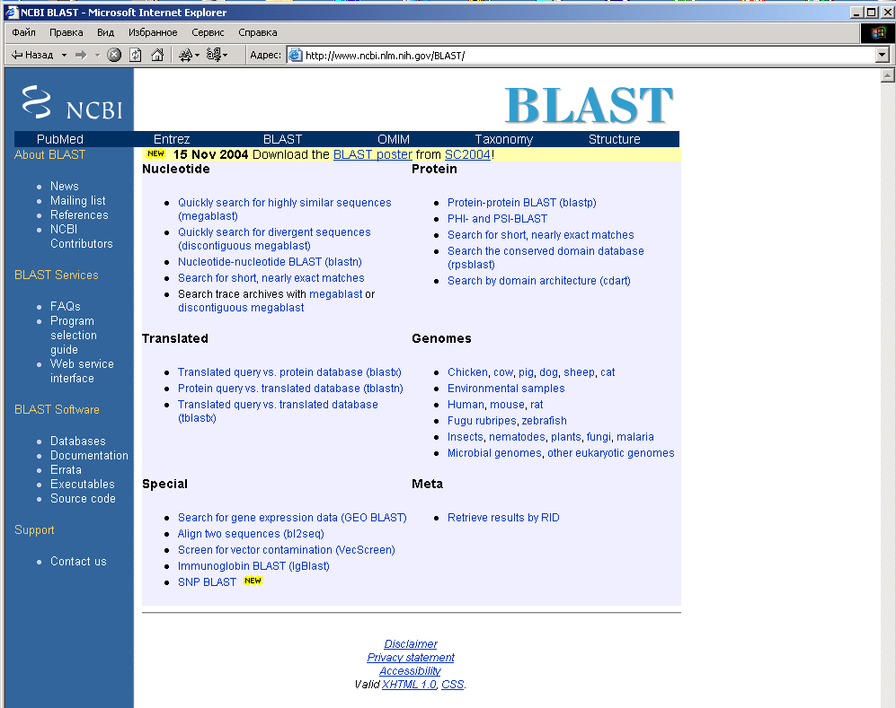
BLAST home page

Slide 3
Definitions
Homology = common origin
Similarity ≠ Homology

Slide 4
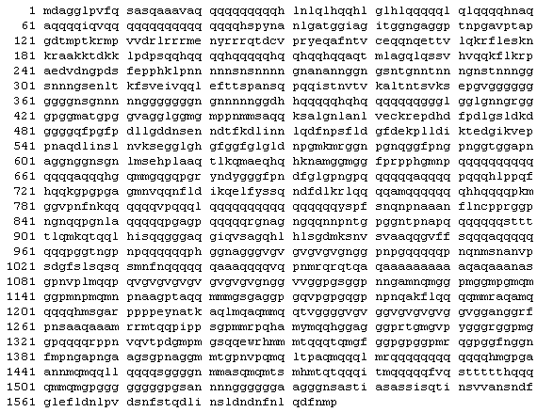
mastermind protein of Drosophila

Slide 5
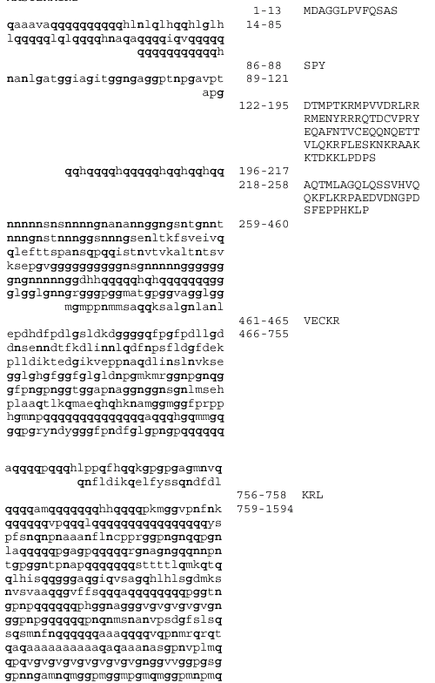
Filtering of low-complexity segments
often insufficient
may lose non-trivial information

Slide 6
ДЗ – 1
Отправить на BLASTP случайную последовательность длиной 666 а/к с 40% глицинов, 25% пролинов, 15% лизинов и 20% остальных аминокислот (с равными частотами).
Отправить на BLASTX случайную последовательность длиной 2000 нуклеотидов с GC-составом 80%.
Отправить на BLASTP случайную последовательность длиной 666 а/к с большим количеством а/к Q, причем группами (так, что вероятность Q после любой буквы равна 1/10, вероятность Q после Q равна 8/10, остальное – с равномерными частотами).
4–6. Сделать то же самое, отключив фильтры (участки низкой сложности, compositional adjustment).
Описать, что получилось (словами, не просто скриншот).

Slide 7
Definitions
Homology = common origin
Similarity ≠ Homology
Partial homology:
structural,
functional,
evolutionary
domains

Slide 8

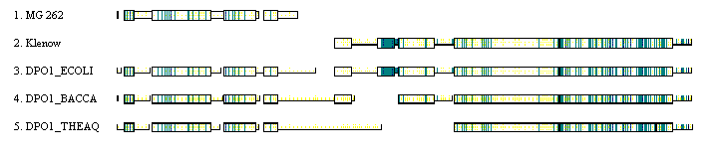
Homology of domains
I64228: “DNA polymerase homolog”
Bacterial DNA polymerases

Slide 9
Homology of domains
I64228: “DNA polymerase homolog”
Klenow fragment

Slide 10
Homology of domains
in fact, 5’-3- exonuclease
Klenow fragment
Bacterial DNA polymerases

Slide 11
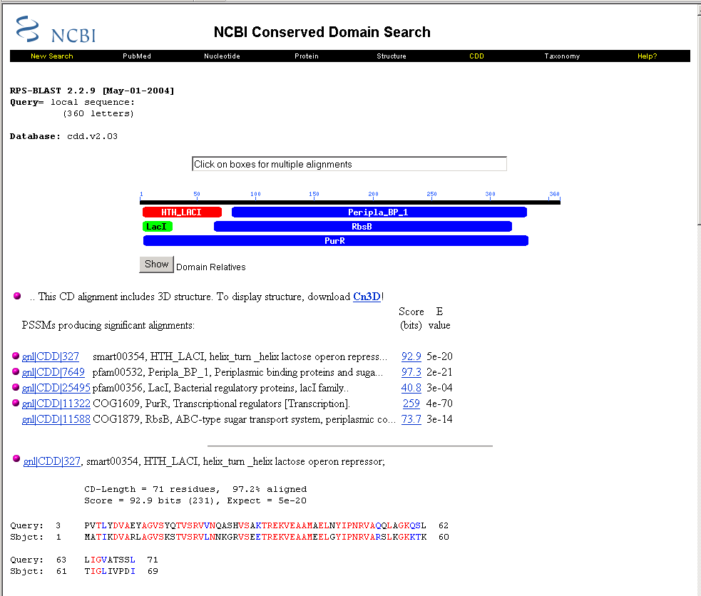
BLAST domains page

Slide 12
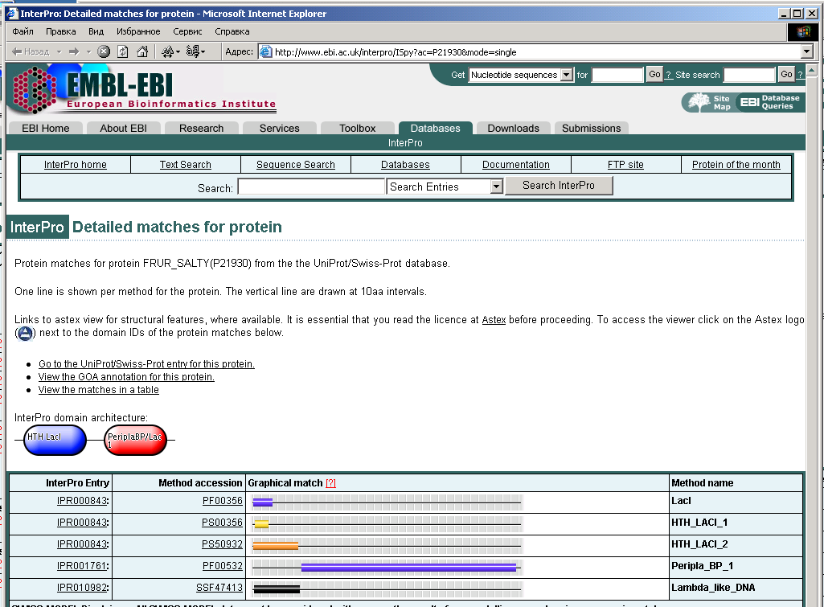
InterPro domains

Slide 13
Orthologs and paralogs
Orthologs: divergence following speciation
Paralogs: divergence following duplication

Slide 14
Orthologs and paralogs
Orthologs: divergence following speciation
Usually same function
Paralogs: divergence following duplication
Same general function, different specificity:
– subfunctionalization
– neofunctionalization

Slide 15
Orthologs and paralogs
Orthologs: divergence following speciation
Usually same function
  BUT: FUR/MUR
Paralogs: divergence following duplication
Same general function, different specificity
  BUT: antifreezes, crystallins

Slide 16

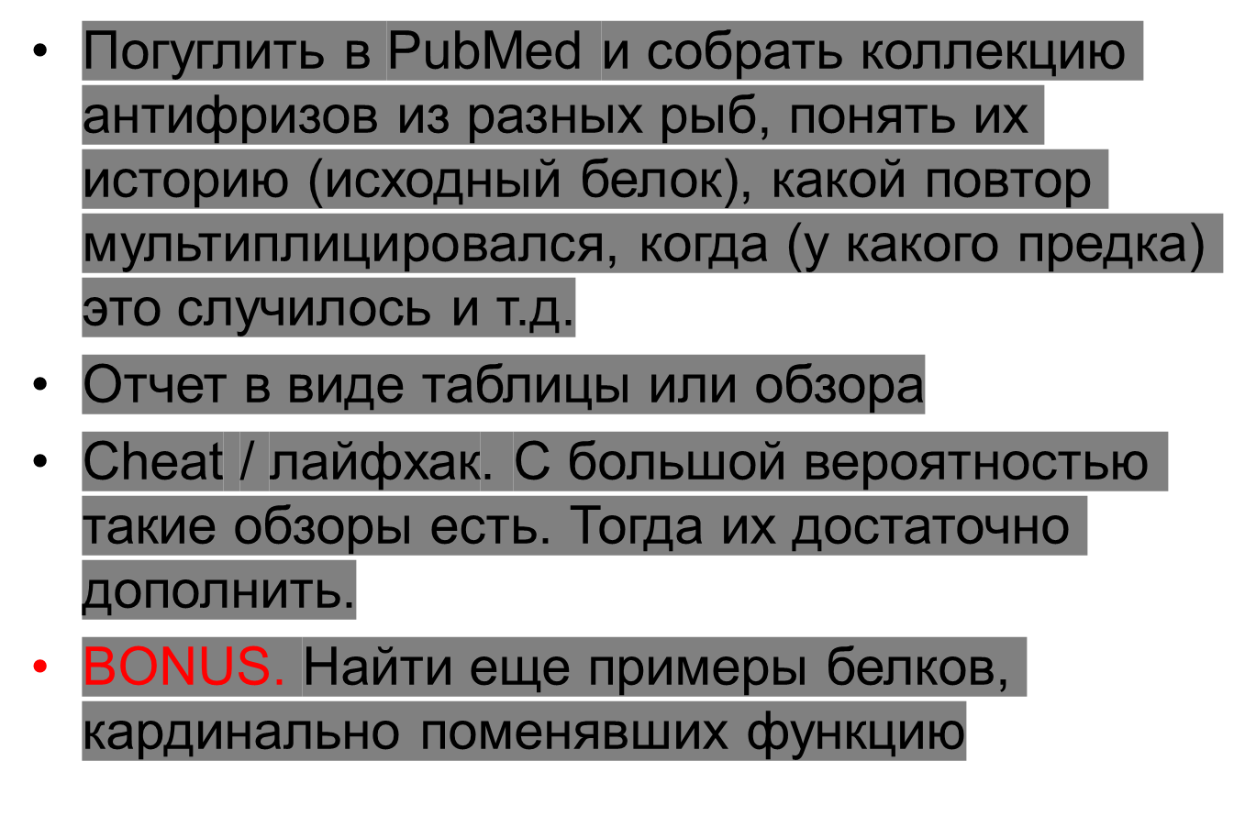

Slide 17
Horizontal gene transfer. Xenologs
Gene tree may be different from species tree
  Duplications
  Deletions
  Horizontal transfer
Hybridization

Slide 18
Orthologs, paralogs and trees
Co-orthologs: (recent) paralogs, orthologous to the same gene in other species
Bidirectional best hits

Slide 19


Slide 20
Reconciliation of trees
Embedding of the species tree into the gene tree with the minimal number of duplications and deletions
  The number of duplications and deletions are linked: more (and earlier) duplications means more deletions – hence they may be minimized simultaneously. No tradeoff. (
… and horizontal transfers
  Problem: how to assign weights to events?
    Embedding w/o HGT is always possible (early duplications and many deletions)
    Vice versa, emedding is possible with HGT only

Slide 22
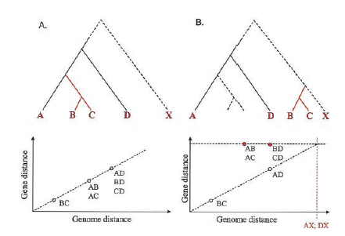
Alternative approach to identification of HGT
Wrong closest relative (mitochondria, Thermotoga, Aquifex)
Genes that are too close to each other (given the distance between species)
Test: how would the tree and plot look like if genome X is known, and there is an even more distant Z?

Slide 23
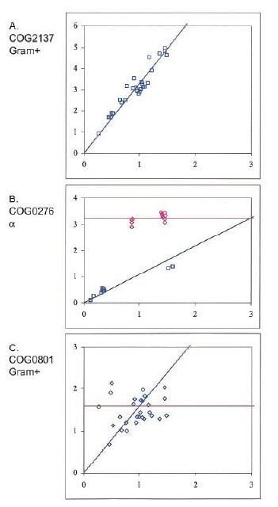
Examples
Horizontal axis:
distance between genomes
Vertical axis:
distance between genes

Slide 24
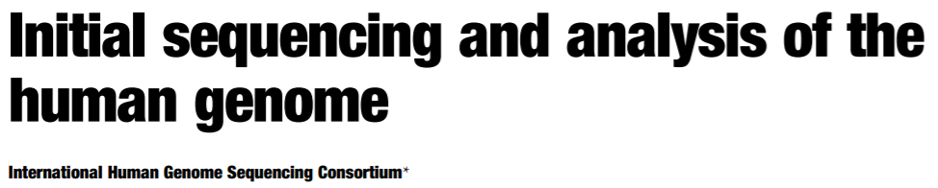
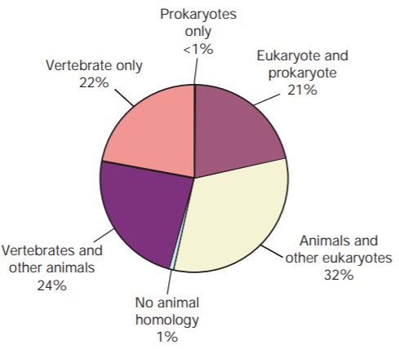

Slide 25

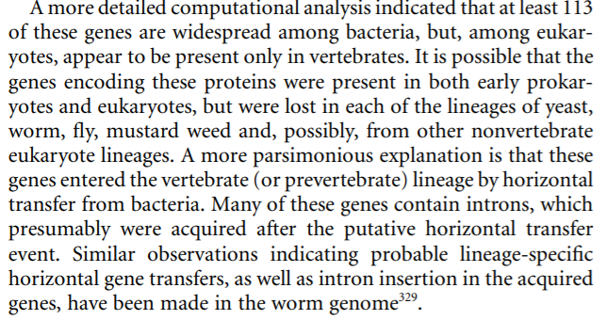

Slide 26
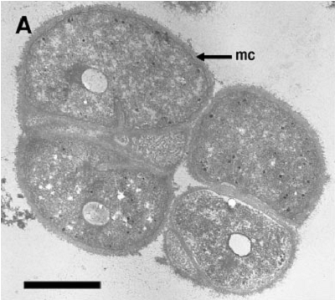
Methanosarcinaceae
Methanosarcina acetivorans C2A
Methanosarcina barkeri str. Fusaro
Methanosarcina mazei Go1
Methanococcoides burtonii DSM 6242
Methanohalobium evestigatum Z-7303
Methanohalophilus mahii DSM 5219
The largest genomes in the Archaea domain
High level of horizontal gene transfer
~30% of genes in M.mazei (Deppenmeier et al., 2002)
~20% of genes in M.acetivorans (Galagan et al., 2002)
high level of abberant sequences in M.burtonii (Allen et al., 2010)
Closely related, but inhabit different environments
~25 % of genes are common for Methanosarcina spp. (Maeder et al.,2006)

Slide 27
Data
bidirectional best BLAST hits with identity cutoff:
Methanosarcina spp. – 50%
Methanosarcinaceae – 40%
 | Number of proteins in ortologous groups | Number of orphan proteins
Methanococcoides burtonii DSM 6242 | 1811 | 462
Methanohalobium evestigatum Z-7303 | 1699 | 555
Methanohalophilus mahii DSM 5219 | 1713 | 274
Methanosarcina acetivorans C2A | 2852 | 1688
Methanosarcina barkeri str. Fusaro | 2548 | 1076
Methanosarcina mazei Go1 | 2537 | 833
OGs containing genes from two or more Methanosarcina

Slide 28
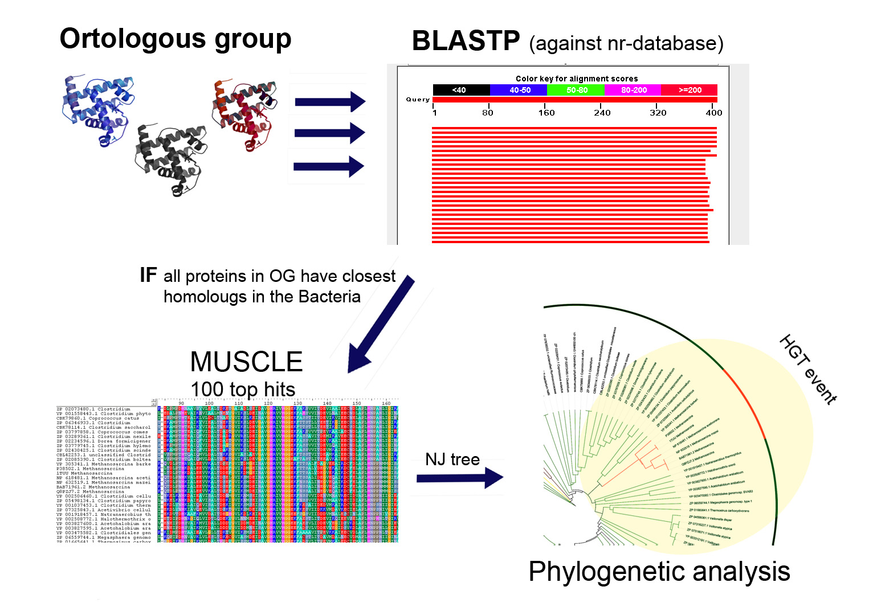
Identification of HGT

Slide 29
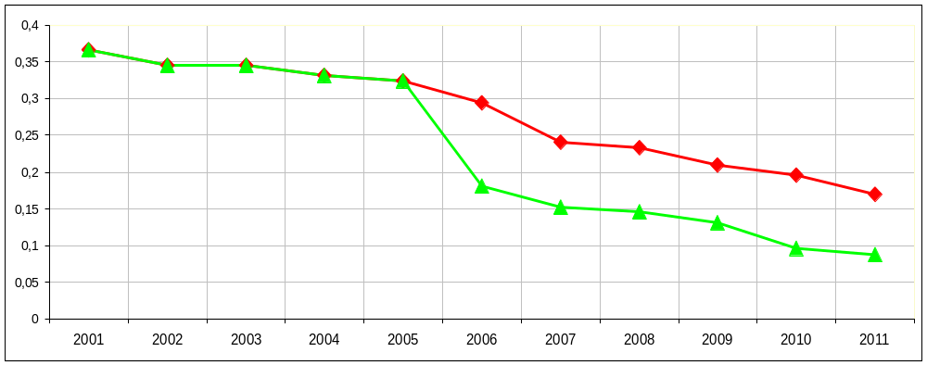
The fraction of horizontally transferred genes in Methanosarcina spp. decreases with time
well, in some sense
timing of HGT: Methanosarcinaceae, Methanosarcina
GenBank year

